Slide 1


















REAL ESTATE
INVESTMENT ANALYSIS
What is the best investment strategy for the Beijing property market?
Li Jiaen | A0255750A
Kwa Jing Rui Edgar | A0271818X
Shakktis Vetriveal | A0307901L
Han Song Yu, Glen | A0307423M
BT2102
Group 20

Slide 2


TABLE OF CONTENTS
01
02
03
CONTEXT
THE DATA
PRICE OVER TIME
Investment Strategies
Understanding the Dataset
Exploring factors which affect Price over Time
04
05
BUILDING CHARACTERISTICS
SELECTING PROPERTIES
How building characteristics affect price
Additional factors that help refine our selection of undervalued properties

Slide 3


01
CONTEXT
Beijing represents a compelling investment opportunity as China's political and economic capital. With rapid urbanization, expanding infrastructure (particularly subway networks), and a growing middle class, the property market has experienced significant transformation.
However, the market is complex—spanning 13 diverse districts with varying price points, property types, and demand dynamics. Without data-driven insights, investors risk misallocating capital in underperforming segments or missing high-potential opportunities.
Our objective: Analyze historical transaction data to identify optimal investment strategies that maximize returns by identifying factors of undervalued properties, providing clear, actionable recommendations for entering this dynamic market.
BEIJING

Slide 4


Beijing House Prices
Our investment team has identified 2 strategies we believe would be the best:
  Invest in houses that have features that are rising in demand
  Invest in potentially undervalued properties

Slide 5
02
Understanding the Dataset
Data cleaning formulation is in Appendix

Slide 6
Variables present in the dataset
Categorical variables:
  livingRoom
  drawingRoom
  kitchen
  bathRoom
  floor
  buildingType
  constructionTime
  renovationCondition
  buildingStructure
  elevator
  fiveYearsProperty
  subway
  district
  floorrange
  tradeYear
Numerical variable:
  DOM
  followers
  totalPrice
  price
  square
  ladderRatio
  communityAverage

Slide 7
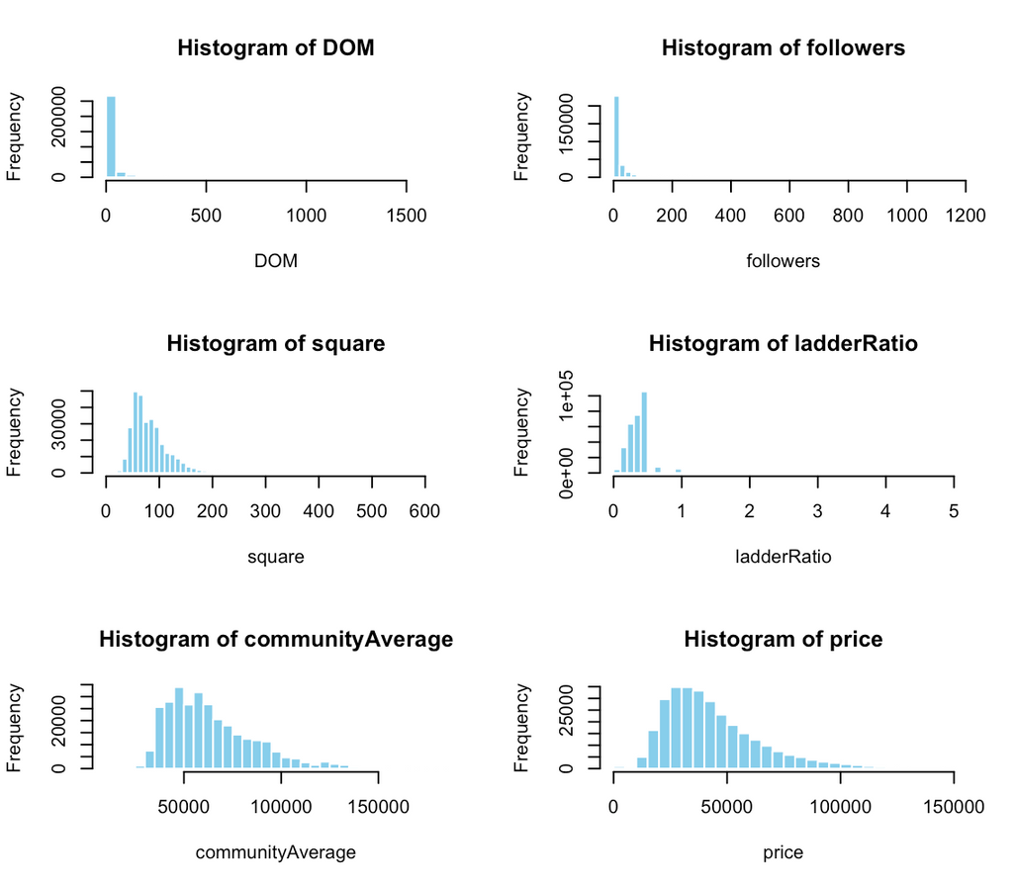
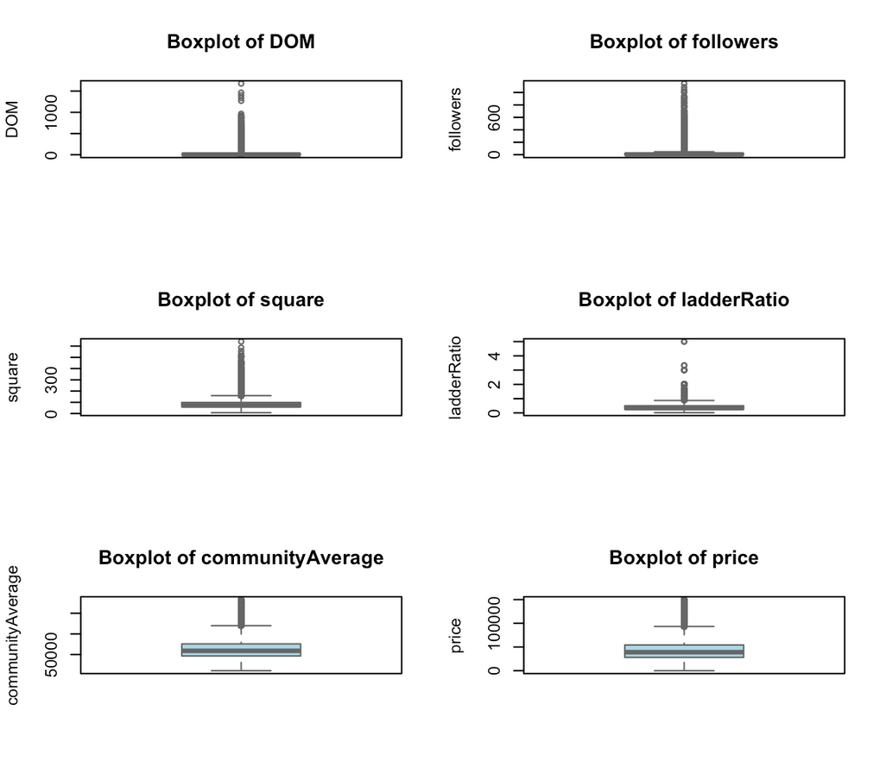
Numerical variables

Slide 8
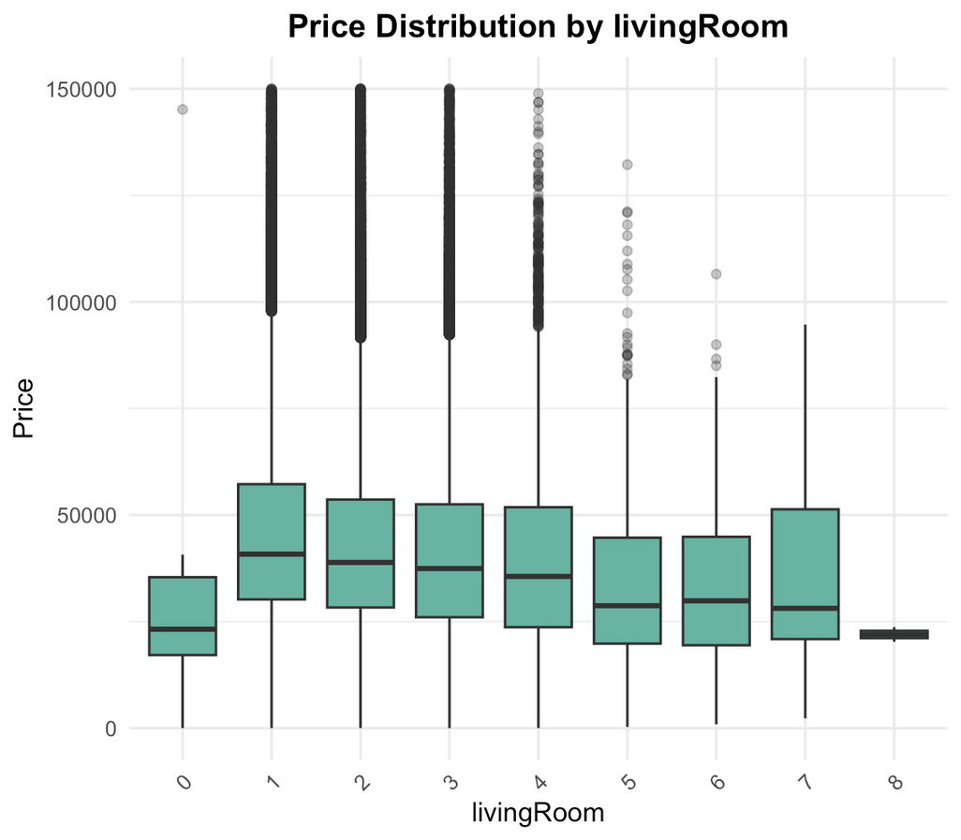
living room

Slide 9
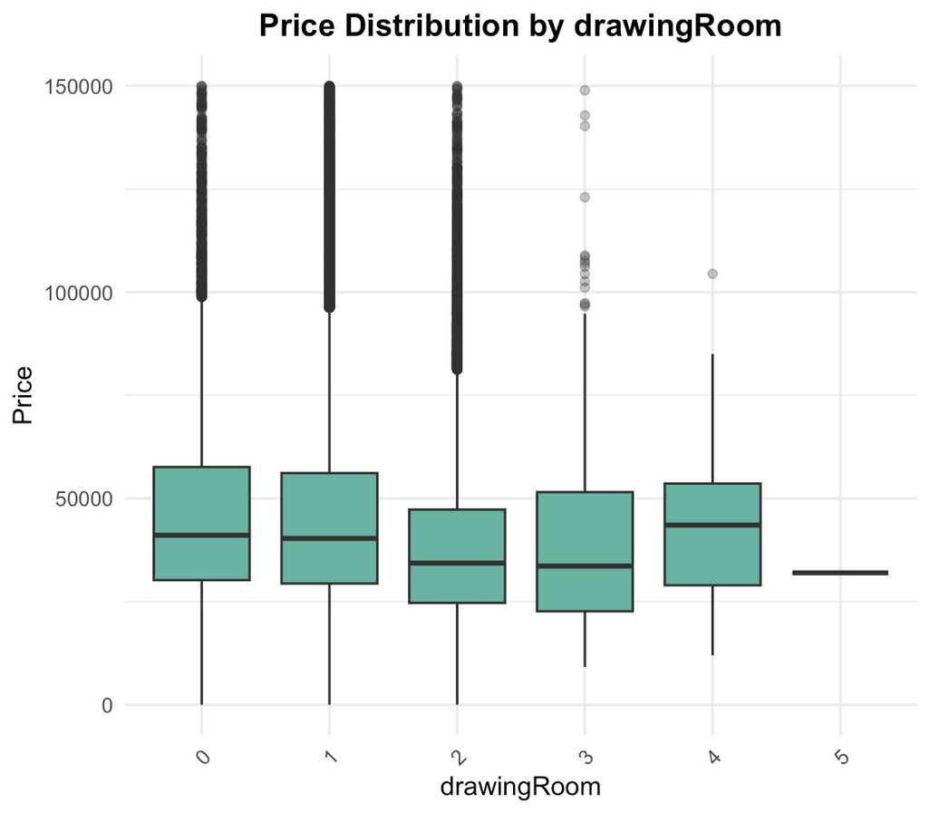
drawing room

Slide 10
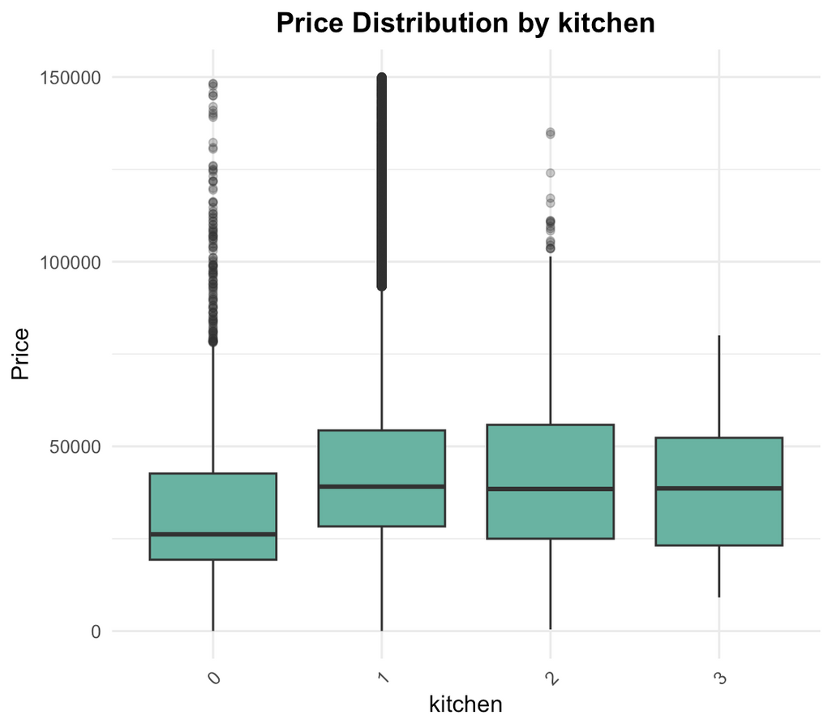
kitchen

Slide 11
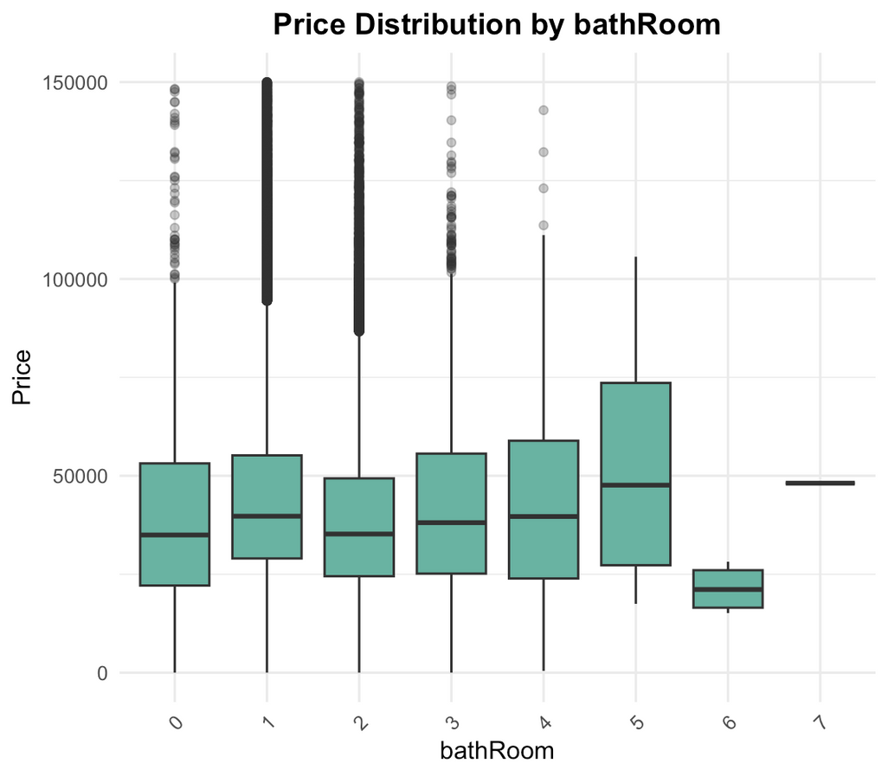
bath room

Slide 12
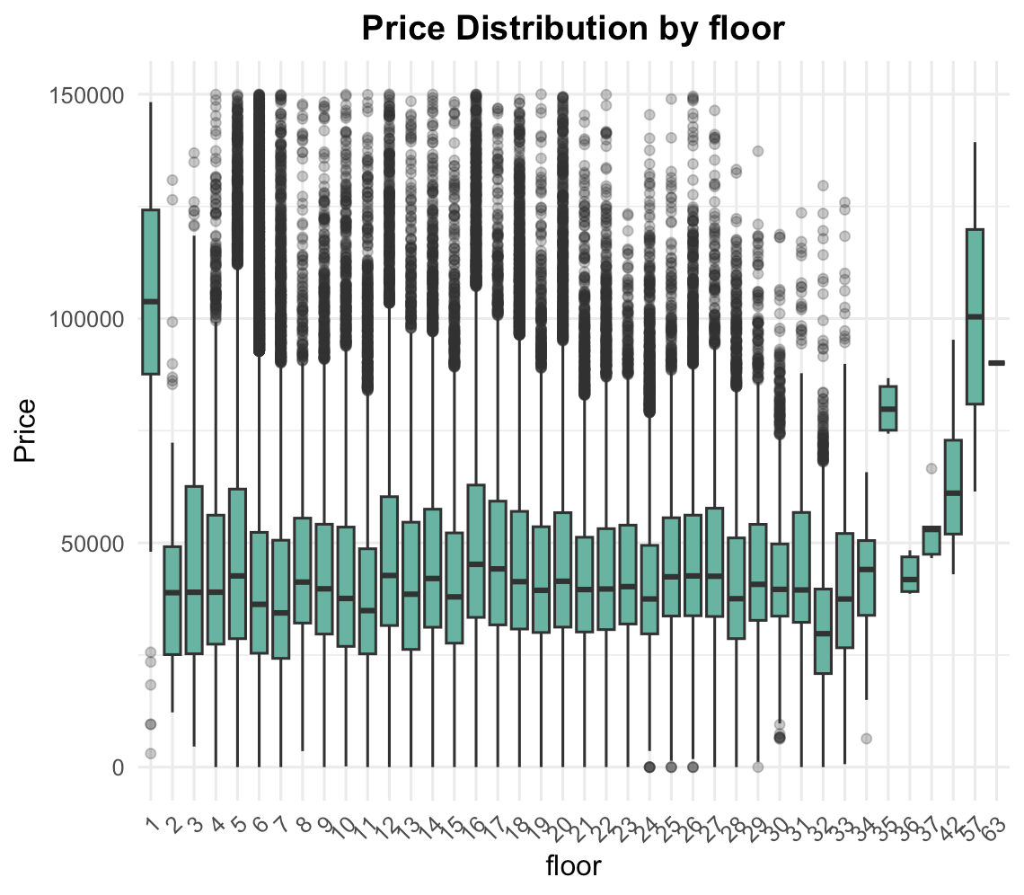
floor

Slide 13
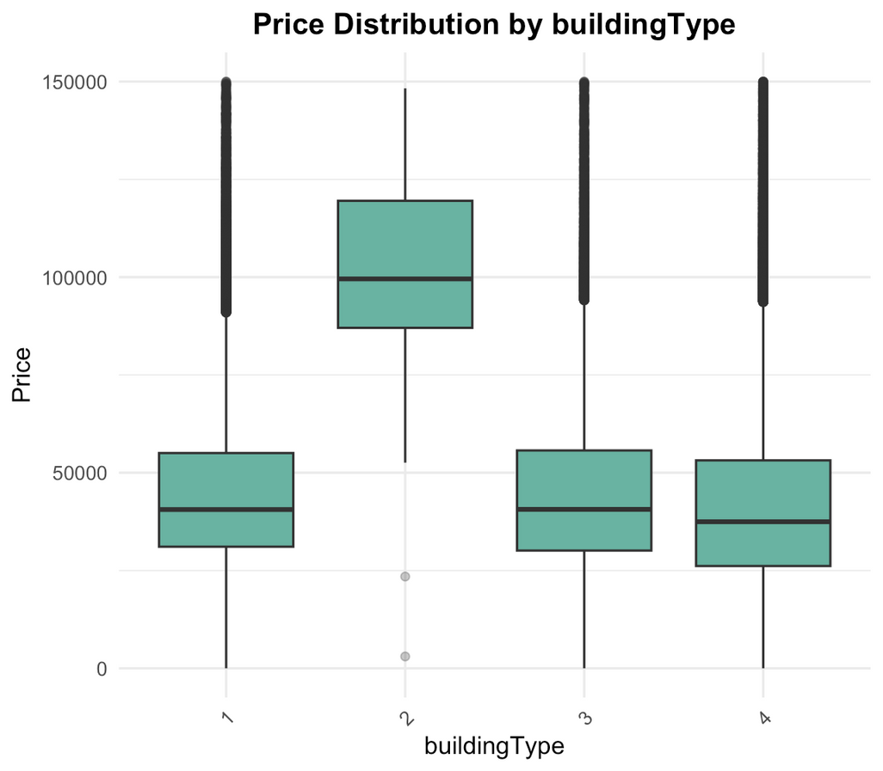
building type

Slide 14
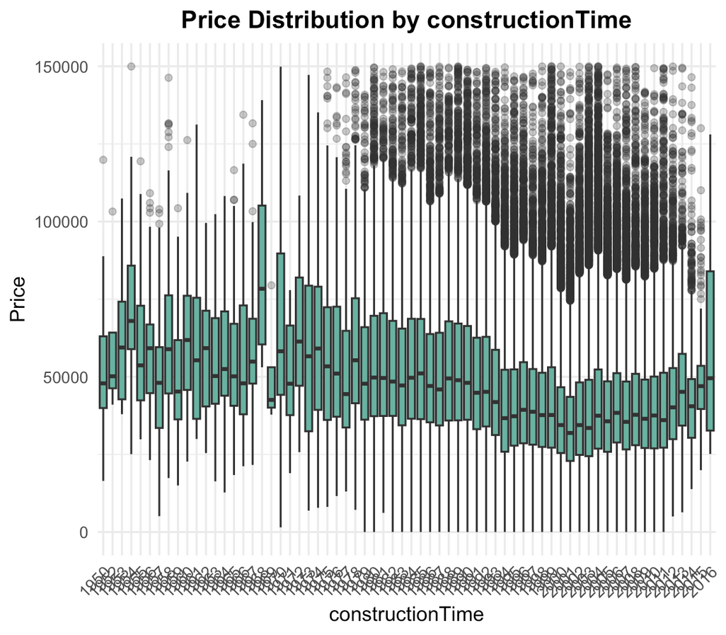
construction time

Slide 15
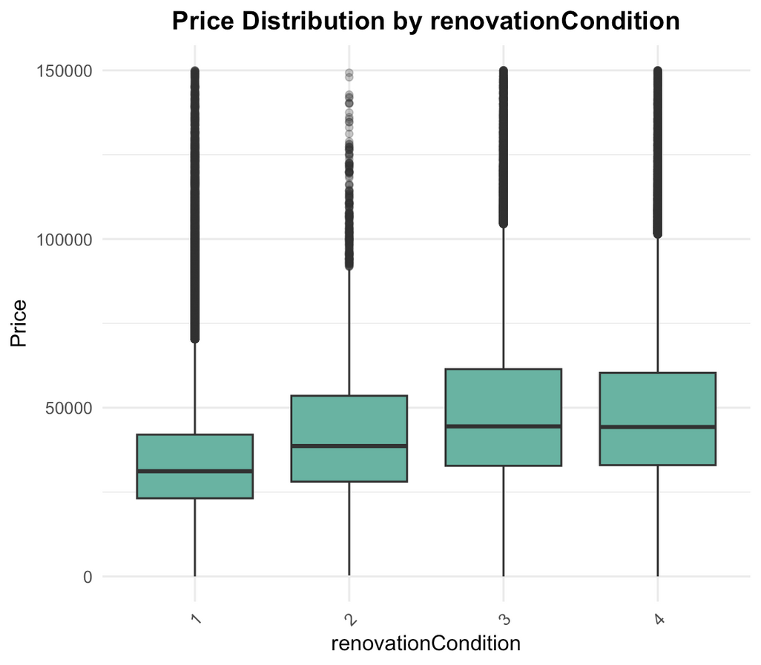
renovation condition

Slide 16
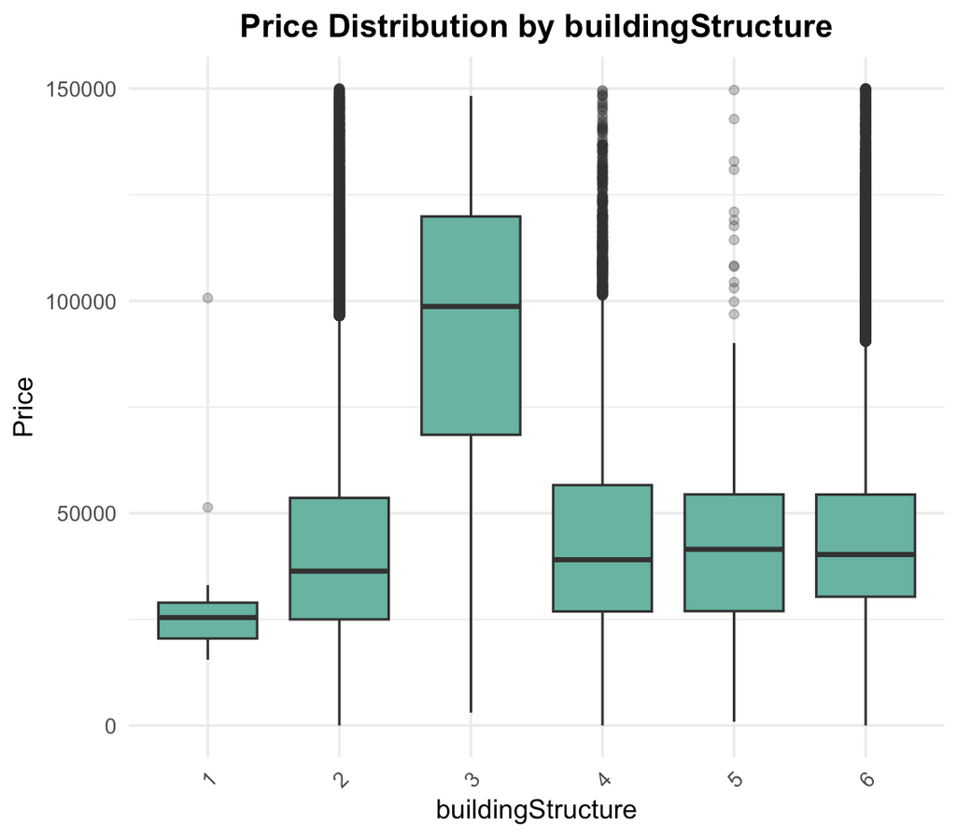
building structure

Slide 17
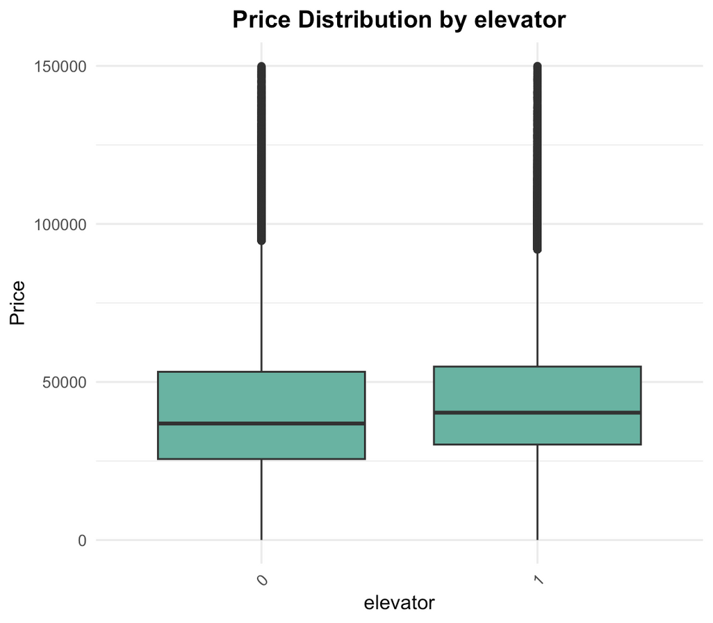
elevator

Slide 18
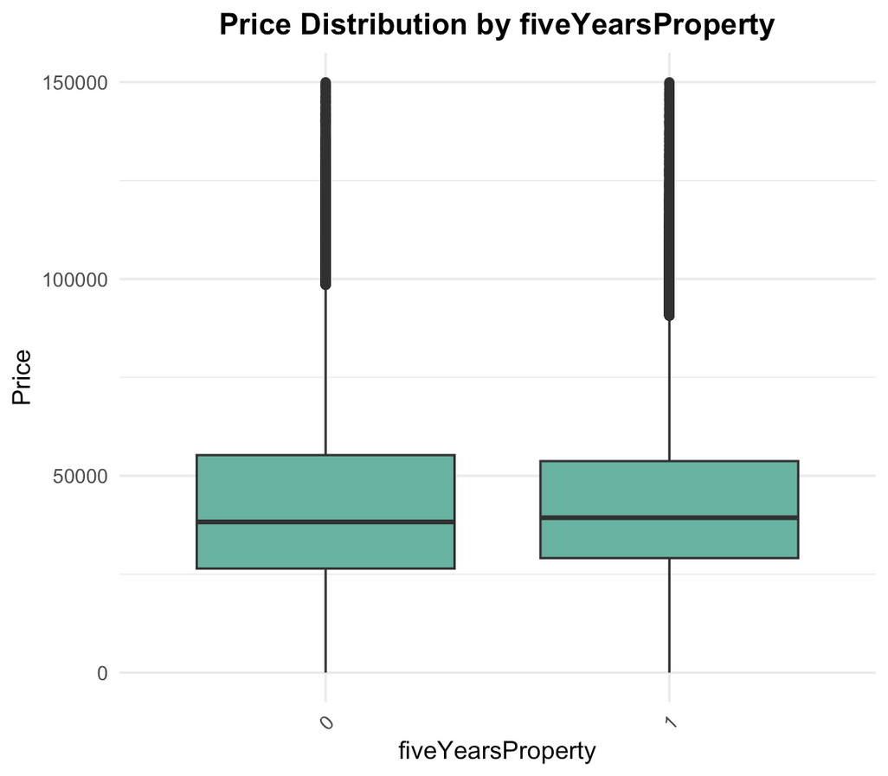
five years property

Slide 19
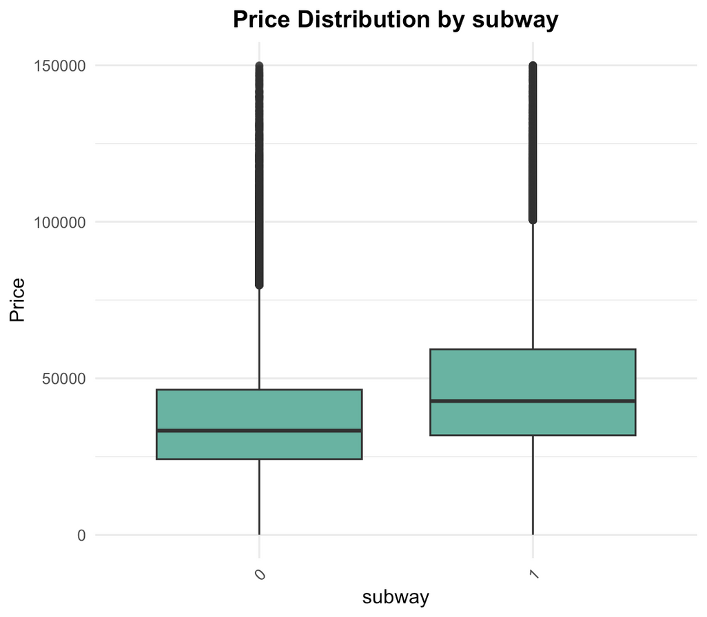
subway

Slide 20
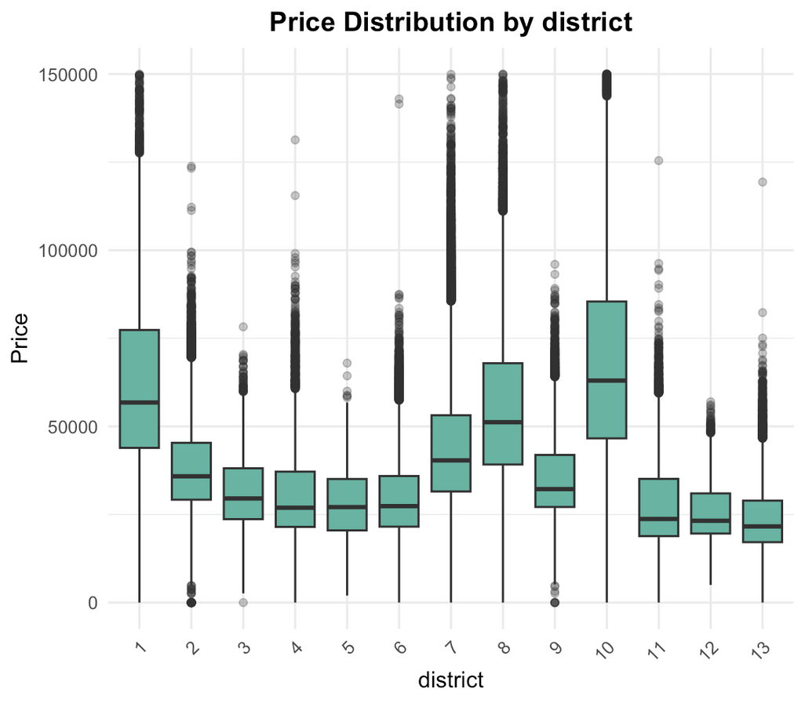
district

Slide 21
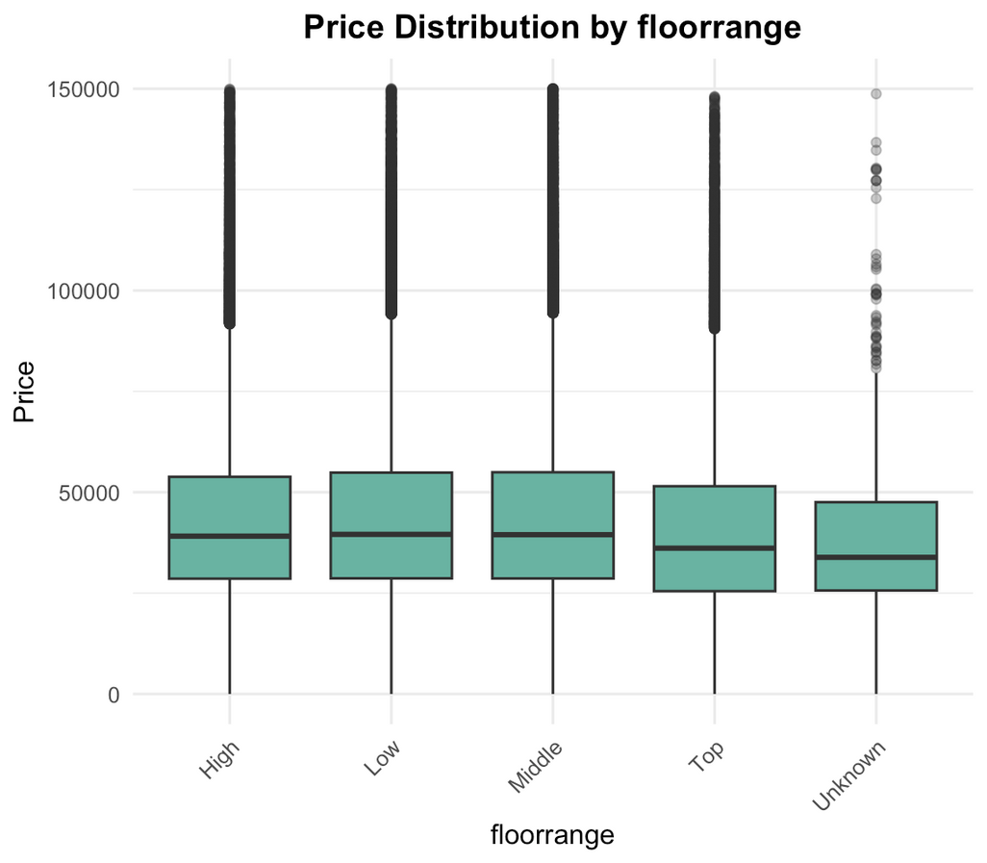
floor range

Slide 22
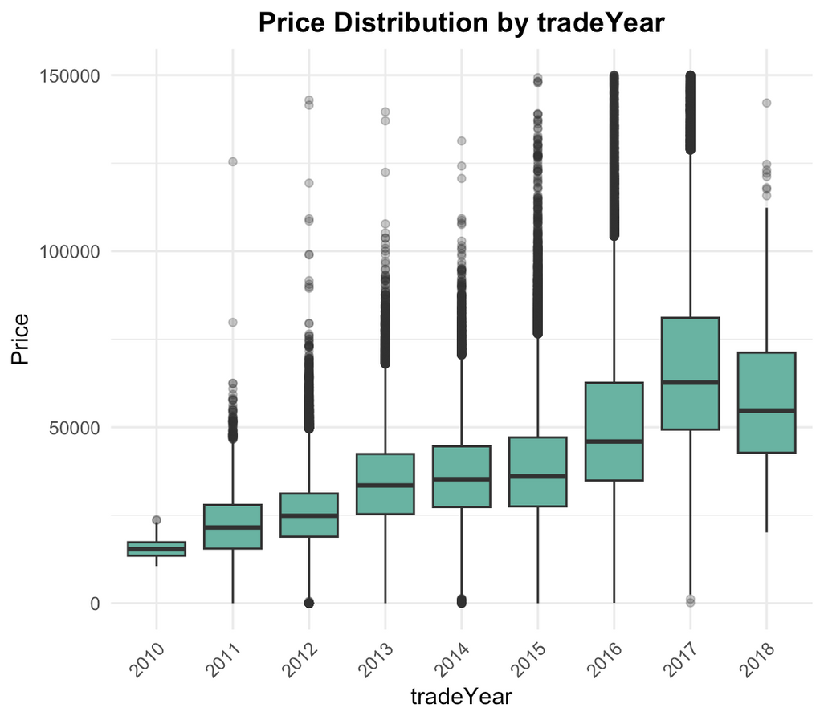
trade year

Slide 23
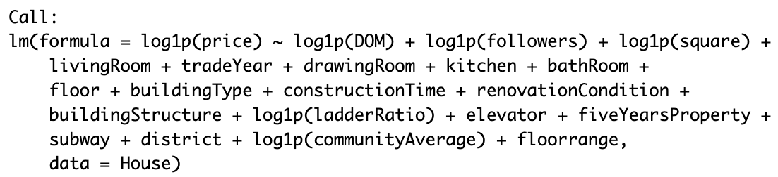
Formation of the variable – Valuation
To find properties that might be potentially undervalued, we first fit linear regression on all the variables. We will log transform the numerical variables as well as they are highly skewed as observed from their histograms. The linear regression formula is shown below. The coefficients will be given in the Appendix.

Slide 24
Formation of the variable – Valuation
Next, we predicted the price of each house using our linear regression model and computed the residuals — the difference between actual and predicted prices.
Based on the residuals, we classified each property into valuation categories using standard-deviation (SD) breaks:
  Undervalued: residual < mean − 1.5 × SD
  Slightly undervalued: mean − 1.5 × SD ≤ residual < mean − 0.5 × SD
  Evenly priced: mean − 0.5 × SD ≤ residual ≤ mean + 0.5 × SD
  Slightly overpriced: mean + 0.5 × SD < residual ≤ mean + 1.5 × SD
  Overpriced: residual > mean + 1.5 × SD
This classification helps us identify which properties are priced above or below their expected market value given their characteristics.

Slide 25
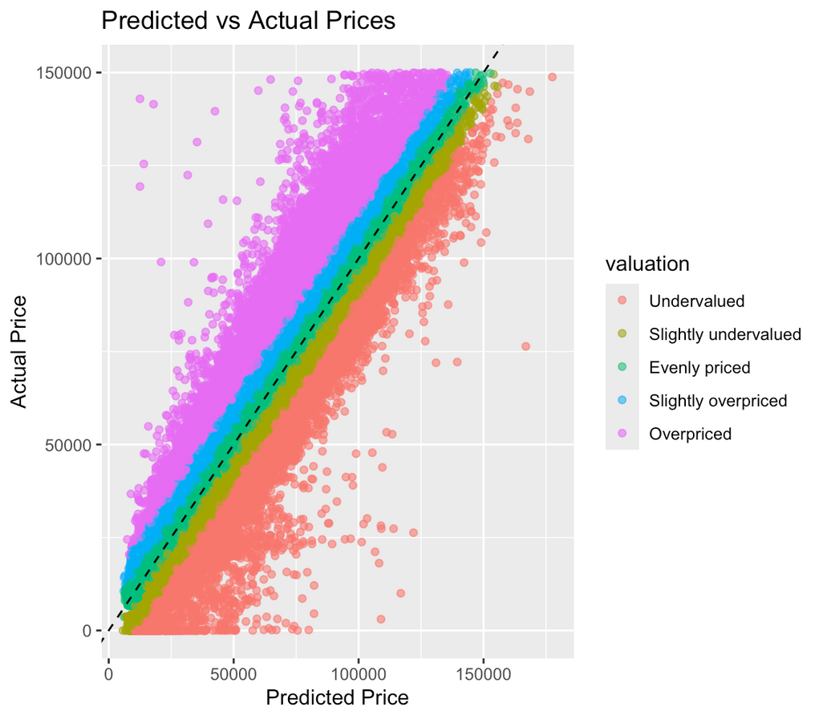
Formation of the variable – Valuation
With these standard deviation breaks, here are the number of observations in each valuation group:
  Undervalued = 13770
  Slightly undervalued = 64661
  Evenly priced = 147710
  Slightly overpriced = 53395
  Overpriced = 18158
The plot of predicted vs actual price is given as well.

Slide 26
Formation of the variable – Price Index
Lastly, we created a Price Index variable, defined as the ratio of actual price to predicted price from our regression model.
This normalization removes the effects of inflation and shifts in the types of houses sold, allowing us to compare real price movements across years and districts.
Since the predicted price accounts for all key features, trends in the Price Index reflect true market changes, rather than confounding factors such as newer or higher-quality houses being built/sold in recent years.

Slide 27

03
Level-2 Question:
What affects Relative Price over Time?

Slide 28
03
Factors
  Number of Bedrooms
  Number of Living Rooms
  Number of Bathrooms
  Number of Kitchens
  Type of Property
  Renovation Condition
  Structure of Property
  Size of Property
  District
  Availability of Subway
  Availability of Elevator

Slide 29
03
Level-3 Questions
Do the number of Bedrooms / Living Rooms / Kitchens / Bathrooms influence Relative Price over Time?
Do certain Types of Property appreciate more in value over Time?
Do certain Build Structures appreciate more in value over Time?
Does larger Size appreciate more in value over Time?
Do certain Districts appreciate more in value over Time?
Does availability of Subway influence value over Time?
Does availability of Elevator influence value over Time?

Slide 30
What happened in 2011?
Before 2011:
  There was excess demand for property from 2005 - 2011, aided by rising labor supply before 2007 and strong productivity improvements afterward. This led to dramatic increase in prices and overvaluation.
2011 & After:
  The Chinese property bubble burst in 2011, when home prices began to slow or fall in Chinese cities.
  The government had introduced strict regulatory measures in 2010-2011, including: banning home sales to those who hadn't lived there for five years (fiveyearpolicy), limiting native families to two homes, and raising interest rates three times in 2011.
Property Prices
2005
2011
2012

Slide 31
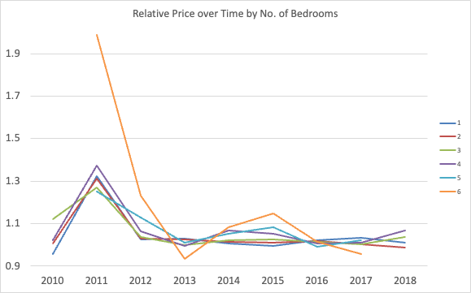
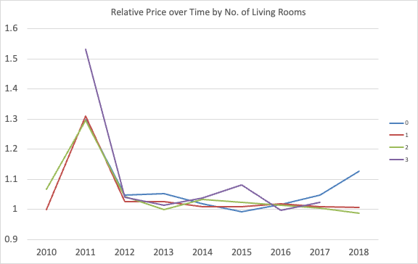
Number of Bedrooms & Living Rooms
6
3
Excluded Properties with 0,7 & 8 Bedrooms due to limited examples, 20, 23 & 2 respectively
In 2011, 3 LR properties had only 8 transactions.
  In 2011, properties with 3 LRs was a dramatic outlier, , this could be attributed to having only 8 transactions.
  Excluding 2011, relative prices of properties with 3 LRs showed greater price fluctuations as compared to 0-2 LR properties.This suggests like 6 BR properties, 3 LR properties operate in a different market segment (luxury/high-end) that's more sensitive to economic conditions.
  Similarly, we will suggest avoiding investing in 3 LR properties.
  In 2011, properties with 6 BRs was a dramatic outlier, this could be attributed to having only 2 transactions.
  Excluding 2011, relative prices of properties with 6 BRs showed greater price fluctuations as compared to 1 - 5 BR properties. This suggests 6 BR properties operate in a different market segment (luxury/high-end) that's more sensitive to economic conditions.
  The greater volatility suggests greater risks, hence we will suggest avoiding investing in 6 BR properties.

Slide 32
Number of Living Rooms
  Properties with 0 - 2 LRs showed synchronized market movements with no significant size-based premium variations over time.
  In 2011, properties with 3 LRs was a dramatic outlier, with relative price above 1.5. However, this could be attributed to having only 8 transactions in 2011.
  Excluding 2011, relative prices of properties with 3 LRs showed greater price fluctuations as compared to 0-2 LR properties.
  This suggests like 6 BR properties, 3 LR properties operate in a different market segment (luxury/high-end) that's more sensitive to economic conditions.
  Similarly, the greater volatility suggests greater risks, hence we will suggest avoiding investing in 3 LR properties.
In 2011, 3 LR properties had only 8 transactions.

Slide 33
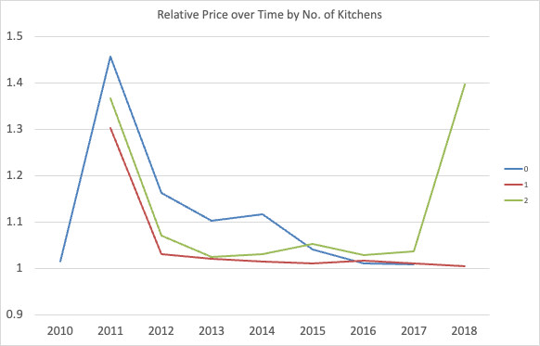
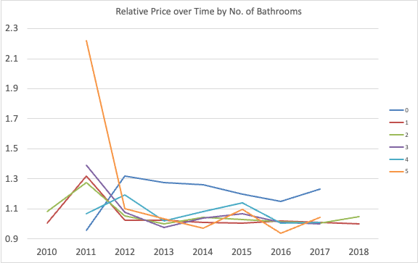
Number of Kitchens & Bathrooms
In 2018, 2 K properties had only 1 transaction.
In 2011, 5 Bathroom properties had only 2 transactions.
  From 2011 - 2014, 0 Kitchen properties were overvalued, this would suggest a strong demand or lack of supply for studio apartments or rentals that shared a kitchen.
  From 2015 - 2018, all kitchen configurations followed a similar trend and converged to similar pricing. This suggests that it is unlikely for any specific Number of Kitchens to influence relative price significantly.
  Excluding 5 Bathroom transactions in 2011, all bathroom configurations except 0, followed a similar trend and converged to similar pricing.
  Relative price of 0 Bathroom properties increased in 2011 and continues to be overvalued as compared to the rest. This could be due to strong demand for affordable compact studio units with shared/external bathrooms. We will suggest investing in 0 Bathroom properties that are below 1.1x relative price.

Slide 34
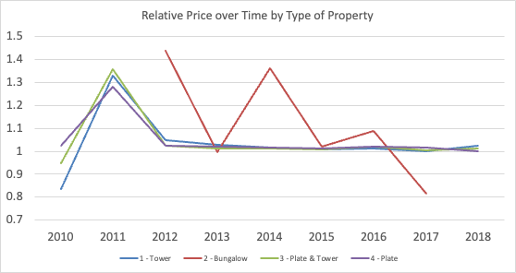
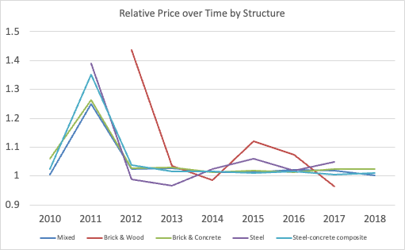
Type of Property & Build Structure
  Towers were undervalued in 2010 relative to other property types. Experienced the strongest appreciation during the boom. Market recognized value and corrected the discount
  By 2012, all 3 types, other than bungalow, stabilised around the 1.0x baseline.
  The dramatic volatility and decline in bungalow prices is the most notable trend, suggesting a fundamental shift away from landed luxury properties. We will suggest avoiding investing in Bungalows into the future.
  However, bungalows only had a total of 44 transactions, which could explain the volatility.
  Builds 3 & 5 (brick and wood, steel) experienced the most volatility, with Brick & Wood looking to continue its downtrend, possibly due to a lack of demand.
  Steel build experienced a downtrend into 2012 & 2013, but has recovered into overvaluation into the following years.
  The other build structures follow a similar trend and converges to the 1.0x baseline.
  Investors should avoid investing in steel build properties as the trend of overvaluation looks to continue into the future.

Slide 35
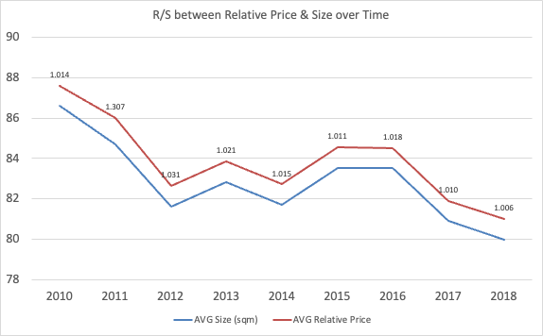
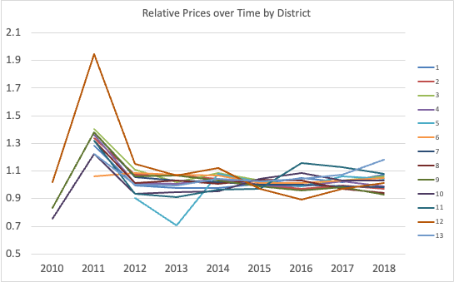
Size & District
13
  Relative price follows the trend of Size, with no anomalies.
  District 12 experienced a boom in price in 2011, but converged towards 1.0x baseline after 2011.
  In 2012, District 5 experienced a dip in prices, but prices recovered after 2013
  All districts have converged close to 1.0x baseline leading up to 2018, in the range of 0.9x - 1.1x, except District 13.

Slide 36
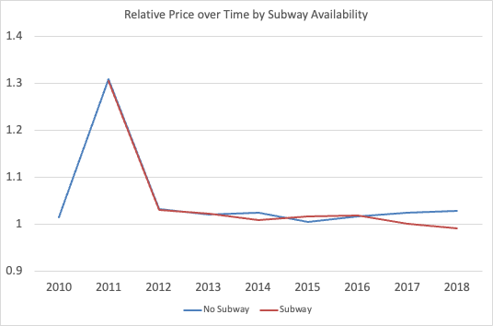
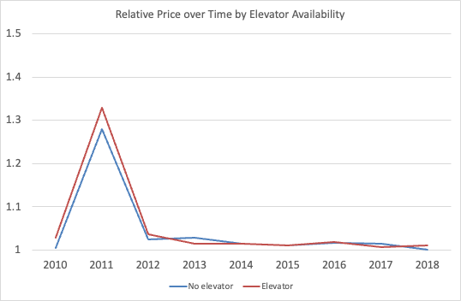
Subway & Elevator
  No significant price difference between properties which have subways nearby and properties who do not.
  Excluded Bungalows from this analysis.
  In 2011, properties with Elevator experienced a slight premium over properties who did not. But price converged to 1.0x baseline after.
  Leading up to 2018, there is no significant price difference between properties which have elevators and properties which do not.

Slide 37
Investing Insights
Avoid Luxury Properties
Avoid Overvalued Properties
Avoid Brick & Wood and Steel
  Luxury properties: Bungalows, properties with 6 Bedrooms or 3 Living rooms.
  These properties experience the most volatility in prices.
  District 13 and properties with 0 Bathrooms have a continuing trend of being overvalued.
  The trend looks to continue past 2018.
  But 0 Bathroom properties have investment potential as strong demand is expected to continue.
  Brick & Wood structured properties looks to be undervalued going past 2018, but this is likely due to a lack of demand as investors seek safer and more modern builds.
  Steel properties look to continue its trend of being overvalued going past 2018.

Slide 38
04
Building Characteristics:
Age x Renovation
Examining effect of property age and rennovation quality on prices

Slide 39
04
Level-2 Question:
Do age and renovation influence house prices?

Slide 40
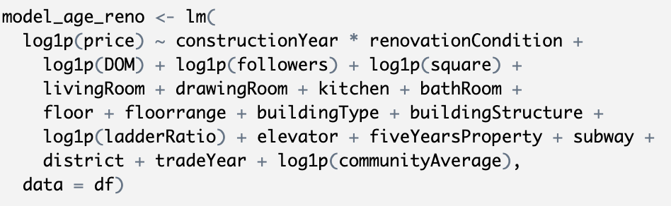
Formation of the variable – Valuation
We estimate a log-linear hedonic model with log(1+price) as the dependent variable, including construction year × renovation condition (interaction) and a comprehensive set of controls — size, rooms (living/drawing/kitchen/bath), floor and floorrange, building type and structure, ladder ratio, elevator, five-year property status, subway proximity, district fixed effects, trade year, listing visibility (followers, DOM), and community average price — to recover the ceteris paribus effects of age and renovation.

Slide 41
04
Level-3 Question:
What is the relationship between construction year and price?

Slide 42
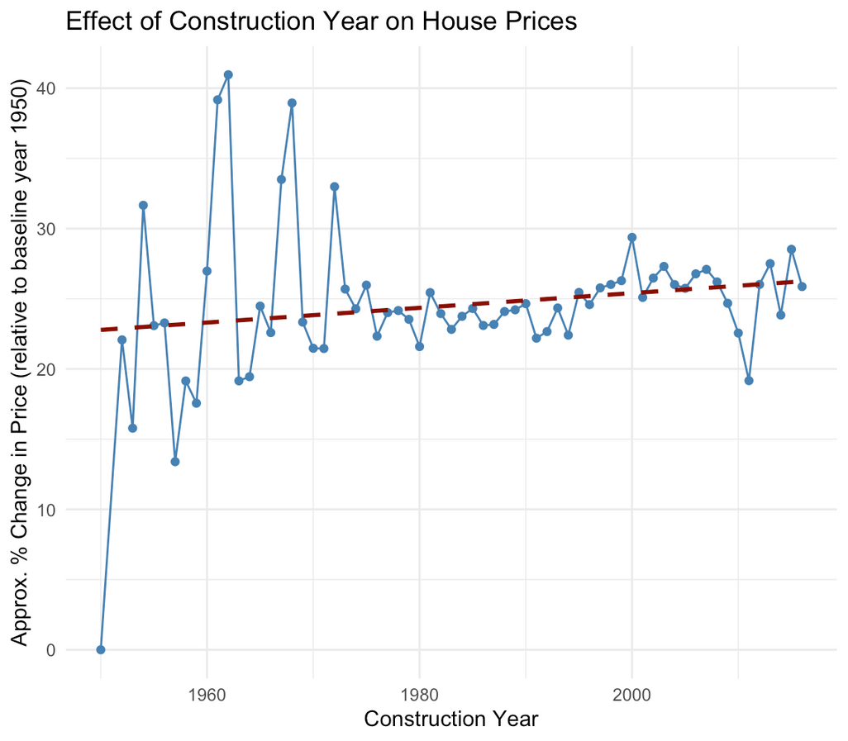
Effect of Construction Year on Price
  The red trend line shows a mild but consistent upward drift, indicating that newer properties command higher predicted prices even after controlling for location, size, and building type.
  Volatility in earlier decades (1950s–1970s) stems from limited transaction volume and sample noise, but from 1980 onward the effect stabilises around a 25–30% premium over the 1950 baseline.
  Investor takeaway: Newer properties command a higher premium than older properties, and the premium is consistently rising. This shows long term demand for recently built units.
  Action point: Invest in recently constructed developments or upcoming projects to capitalize on the premium. Alternatively, renovate older properties to mimic the appeal of new constructions to bridge the value gap.

Slide 43
04
Level-3 Question:
How does renovation quality affect property prices?

Slide 44
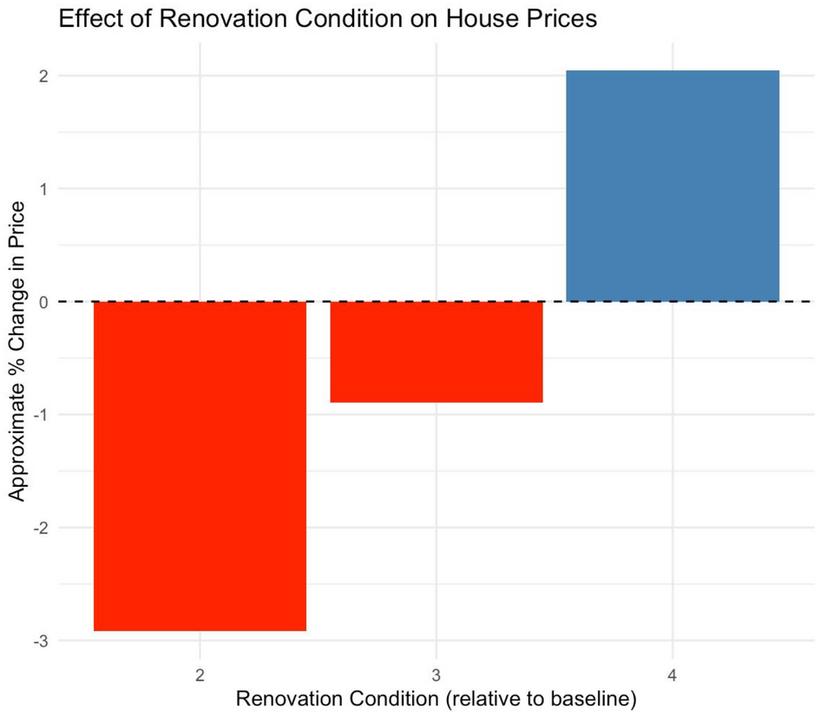
Renovation condition vs Price per sqm
  High-quality renovation (Condition 4) increases predicted total price by roughly +2%, while low renovation conditions (2 and 3) reduce predicted price by up to –3% relative to baseline (Condition 1).
  The pattern remains after controlling for construction year, district, size, and listing visibility, proving the premium is driven by unit condition, not location bias.
  Investor Takeaway: Renovation quality is a direct, value-add lever—buyers price in move-in readiness, so physical condition translates directly into market value.
  Action Point: Upgrade under-renovated units to at least mid-quality condition; marginal renovation lifts expected resale price by several percentage points and enhances liquidity.

Slide 45
04
Level-3 Question:
Does renovation quality moderate the effect of property age on price?

Slide 46
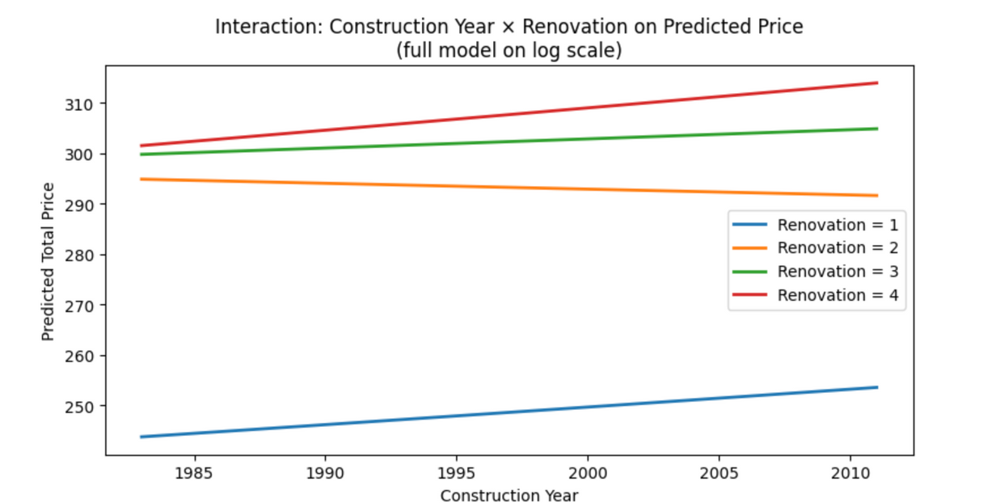
Rennovation x Age: Adjusted price lines
  Predicted price lines are flatter for higher renovation levels, showing that good renovation mitigates age-related depreciation even after controlling for size, district, and listing metrics.
  The steep negative slope for older, low-renovation homes identifies value traps—units that stay cheap because condition fails to offset physical ageing.
  Investor Takeaway:Renovation and age interact multiplicatively: upgrading older units can replicate much of the new-build premium without paying for new construction.
  Action Point: Target older, low-renovation properties in stable districts, plan for upgrade investment, and capture the uplift that narrows the age discount identified in this model.

Slide 47
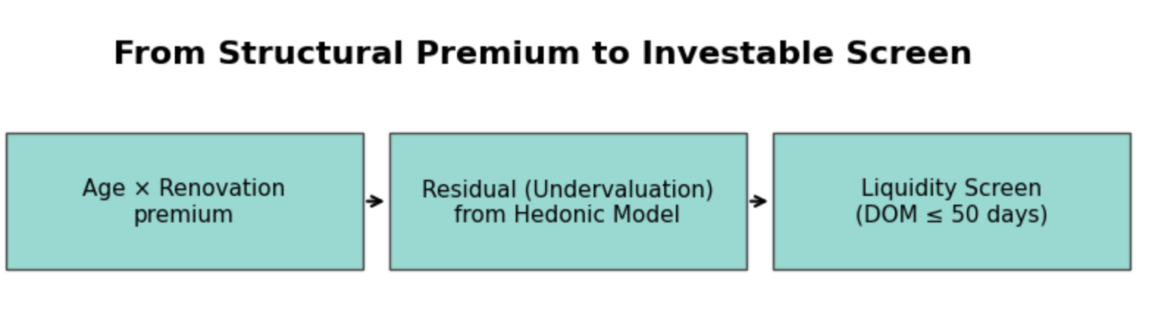
Synthesis Flow Diagram

Slide 48

05
Level-2 Question:
What additional factors help refine our undervalued property selection?

Slide 49


What factors matter most?

Slide 50
05
Level-3 Question:
Are older properties more likely to be undervalued

Slide 51
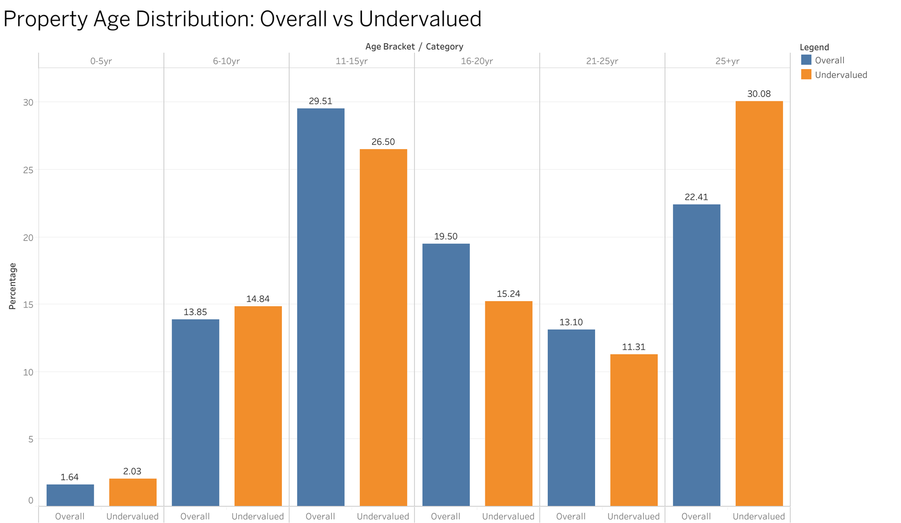
Property Age Shows Strong Association with Undervaluation
Key Findings:
Age 25+ years:
  30% of undervalued
  22% of overall market
  7.7% over-representation
Insights:
  Properties 25+ years old are significantly more likely to be undervalued
But WHY are they undervalued?
T-test: t = 16.73, p < 0.001

Slide 52
But Does Age Equal Low Demand?
Finding: Age 25+ represents 30% of undervalued but only 22% of overall market
Why are they undervalued?
💎 Theory 1: Market Inefficiency
Buyers overlook older properties → Creates genuine bargains
⚠️ Theory 2: Low Demand
Nobody wants old properties → Hard to sell, liquidity risk
Which theory is correct? Let's test...

Slide 53
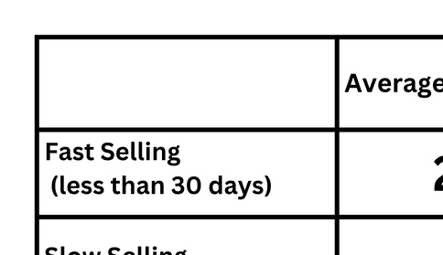


Demand Test: Do Older Properties Sell Slower?
If old properties are undervalued due to low demand, then slow-sellers should be OLDER
Results:
Finding: Older properties sell FASTER
Theory 1 correct: Age = Opportunity
Theory 2 wrong: Age ≠ Low demand
Safe to target older properties

Slide 54

05
Level-3 Question:
Do undervalued properties have low DOM?

Slide 55


Do Undervalued Properties Sell Faster?
Why Liquidity Matters:
  Need to exit positions quickly
  Days on Market (DOM) = liquidity measure
  Fast-moving properties = lower risk
Our Hypothesis:
Undervalued properties should have LOWEST Days on Market
Why?
  Buyers recognize bargains
  Lower prices attract more buyers
  Should move quickly

Slide 56
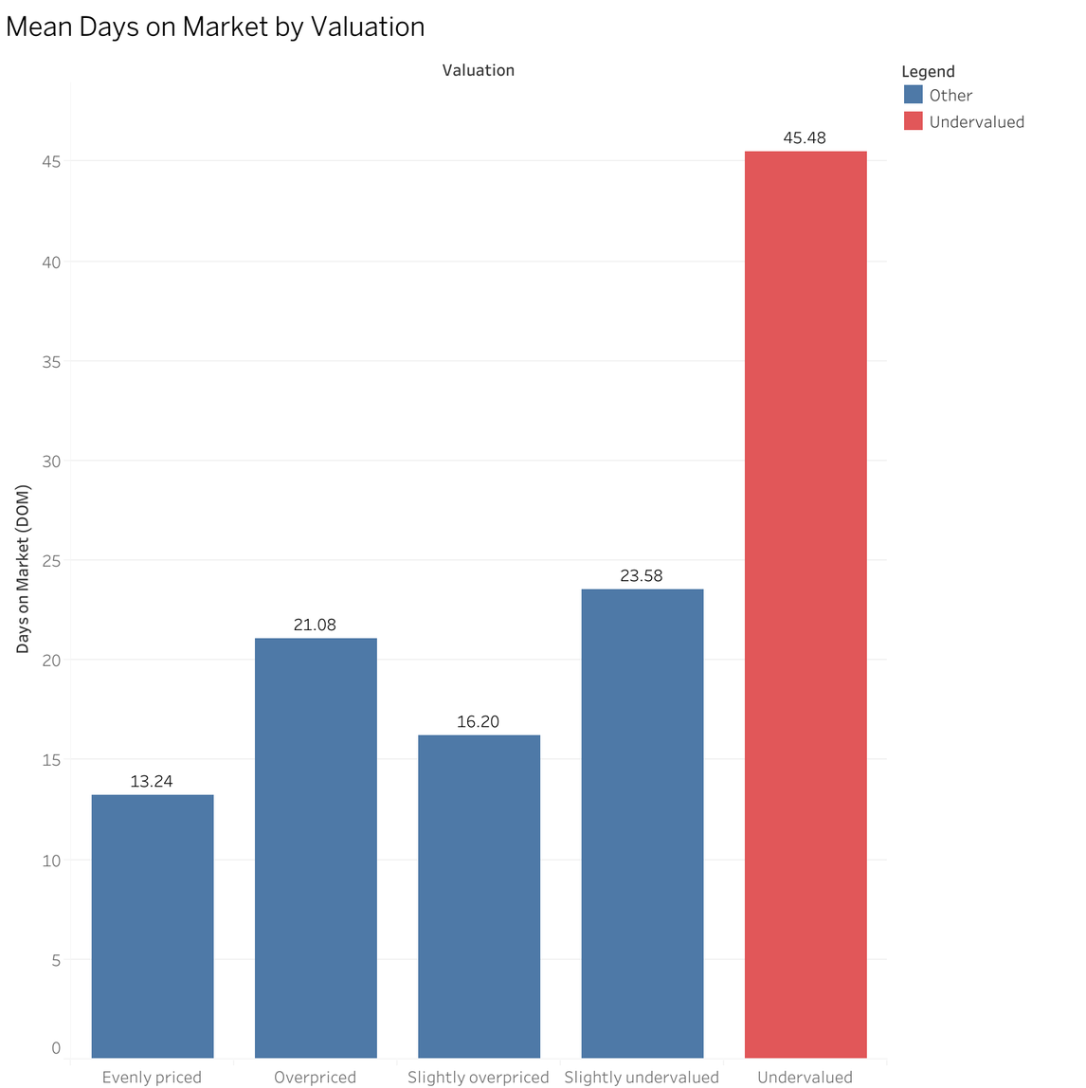
Reality: Undervalued Properties Take LONGEST to Sell
Key Finding:
  Undervalued: 45.5 days
  Evenly priced: 13.2 days
  Difference: 243% longer
Statistically Significant:
ANOVA: F = 2915
p-value < 0.001

Slide 57
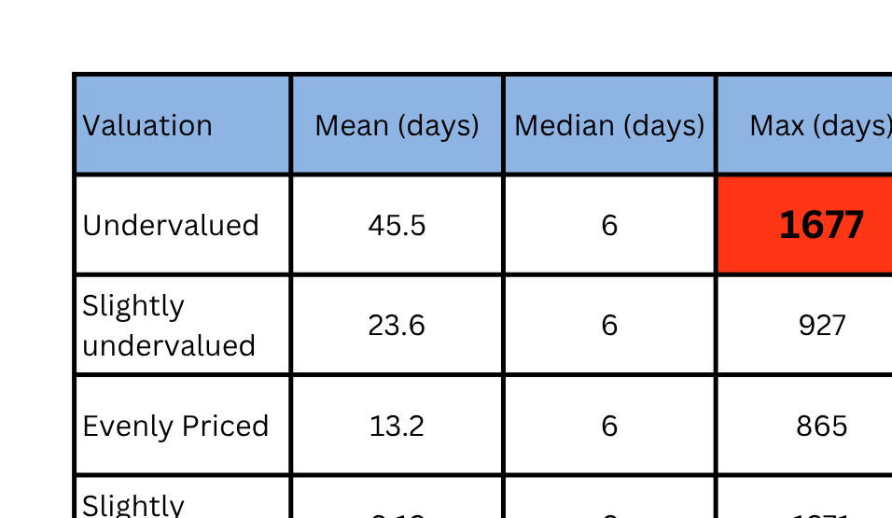
Reality: Undervalued Properties Take LONGEST to Sell
Two Property Types Identified:
Type A: True Bargains
  Median: 6 Days
  Fast Selling
Type B: Problem Properties
  Some sit 1,000+ days
  Drag average up
Key Paradox: Same median (6 days) BUT mean is 3.4× higher → Extreme outliers!

Slide 58



Investment Strategy Implication
Naive Approach
  Buy all undervalue
  Risk: Type B problems
Days on Market is our MOST CRITICAL screening criterion (243% variation)
Smart Approach
  Filter by sale velocity
  DOM ≤ 50 days
  Eliminates problems
  Ensures liquidity

Slide 59

Recommendations
Features | Age | Undervalued
Avoid Luxury Properties (Bungalow, 6BR, 3LR) due to volatility. Avoid District 13 due to continuing trend of overvaluation. Avoid Brick & Wood (Lack of Demand) and Steel (Overvalued) structured properties. 0 Bathroom Properties have investment potential due to sustained demand, despite overvaluation. | Prioritise acquiring older, low-renovation but structurally sound units in stable districts. Budget targeted upgrades to convert the age discount into a new-build-like premium with superior ROI. Invest in recently constructed developments or upcoming projects to capture the premium for recently built properties. | Target properties 25+ years old with DOM ≤ 50 days This captures the age opportunity while avoiding liquidity traps.

Slide 60



THANK YOU
CREDITS: This presentation template was created by Slidesgo, including icons by Flaticon, and infographics & images by Freepik.
Please keep this slide for attribution.

Slide 61
Appendix:
Data cleaning

Slide 62
Software of choice: R
Before we go into cleaning the Beijing House prices dataset, we should look at what we are dealing with

Slide 63
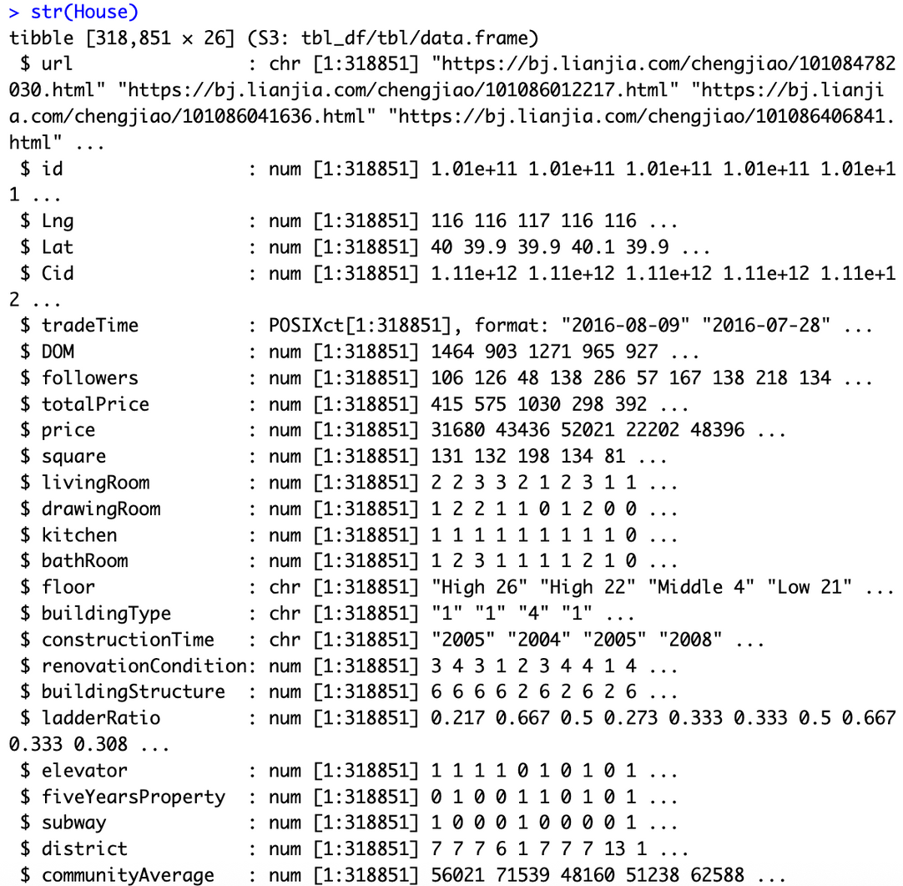
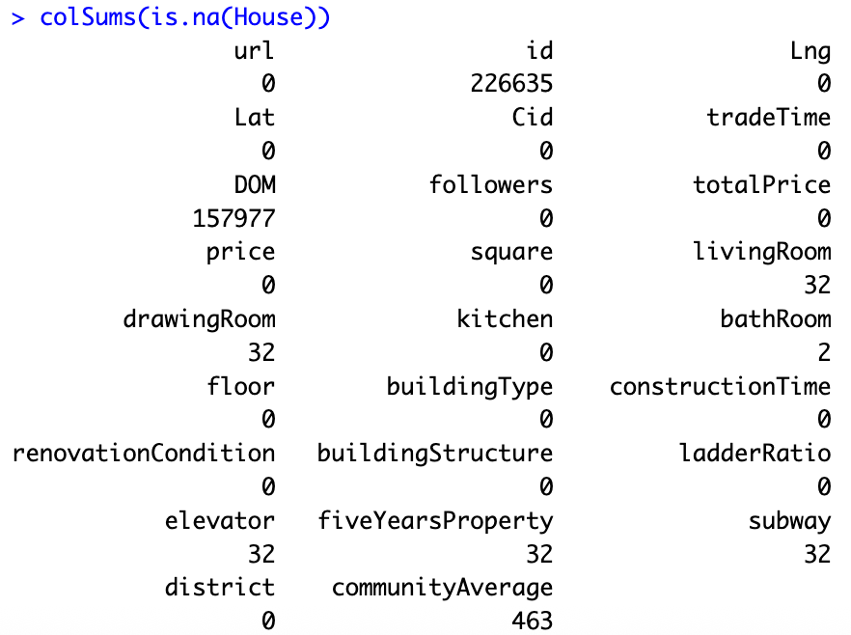

Slide 64
Problems
  NA values (Mostly for DOM)
  floor is a character variable with “Num Char” as the string
  buildingType is a character variable when it should be a numerical variable which will be converted into a factor later
  constructionTime is a character variable when it should be a numerical variable which will be converted into a factor later
  The reason buildingType and constructionTime is a character variable is due to them having strings in their contents

Slide 65
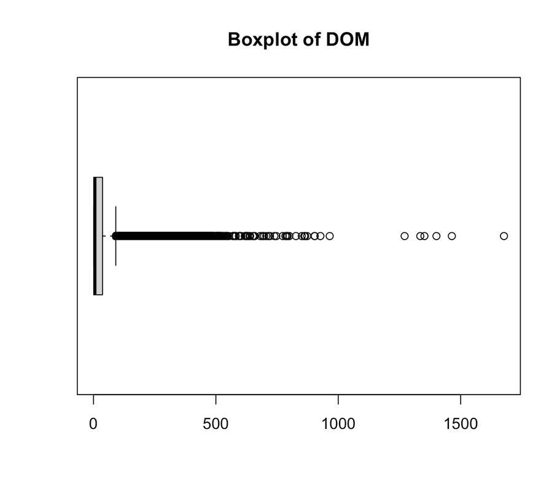
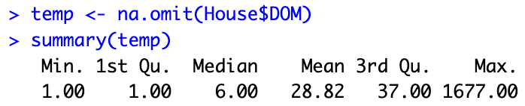
NA Values for DOM
Since DOM contains large amount of NA values, it is unreasonable to outright discard them, we will have to find a way to assign a value to those with NA
Looking at the boxplot for DOM, we can see that it is highly skewed, ranging from 1 to 1677, with most of the observations falling around 1 to 37. Thus, for NA values of DOM, we will assign the median value, 6, to them instead of mean, 28.82.

Slide 66
NA values
For the analysis itself, variables like url, id, Cid are irrelevent thus will be dropped. For the remaining variables that are relevant in the analysis, we will drop rows with NA values as they only account to a very small percentage of the data.

Slide 67
floor
As floor variable is stored as a string with the format “Num Char”, we will split them up by creating a new variable, floorrange. Thus, floor will keep the numerical value while floorrange will take the character.

Slide 68
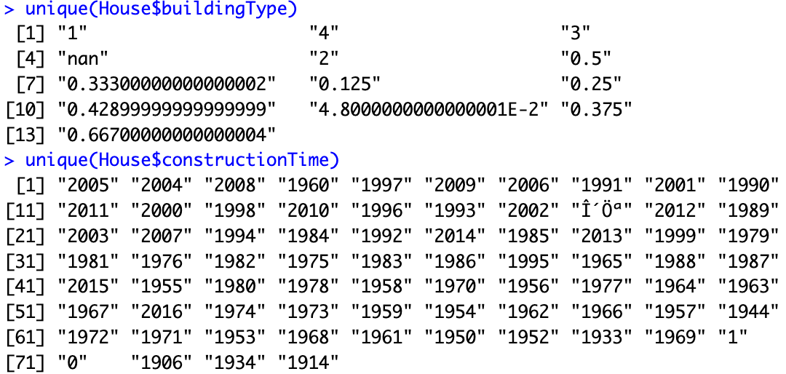
buildingType and constructionTime
Below is the unique values for buildingType and constructionTime. We can see that for buildingType, NA values are stored as a string “nan”. While for constructionTime, there are weird characters stored as string. We will remove those and assign them as NA.

Slide 69
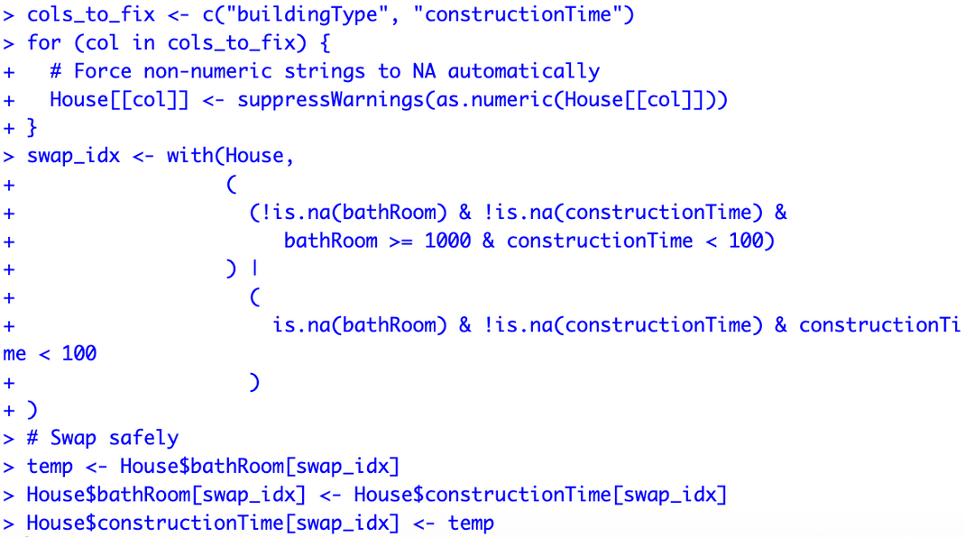
buildingType and constructionTime
We also convert all string to numeric, and non-numeric strings will become NA. For constuctionTime, we see that there are some values are not 4 digits. On the other hand, we check that bathRoom actually has values that are 4 digits. We assume that these values have been incorrectly inputed and swap those values to the right variable.

Slide 70
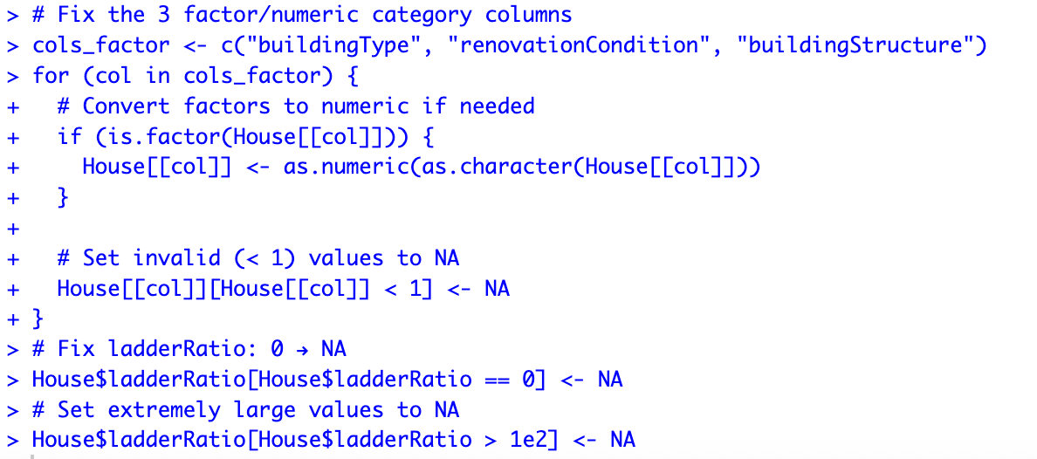
Float vs Integer
There are a few variables that should have integer values but instead have float in them. We convert all values to integer, and assign NA to the float values. For ladderRatio, we exclude houses with ladderRatio = 0 and ladderRatio > 100. ladderRatio is not possible to be 0 unless it is 1 floor landed house and ladderRatio is impossible to be larger than 100.

Slide 71
Further modifications to the dataset
We also extracted the year from tradeTime to create a new variable called tradeYear. Then we convert the variables that should be a factor to be a factor. Lastly, we omit all rows that contain NA values. We also decided to exlude Year 2002, 2003 and 2009 as there are very little data from those years, leaving us with 297694 observations.

Slide 72
Appendix:
Linear regression coefficients

Slide 73
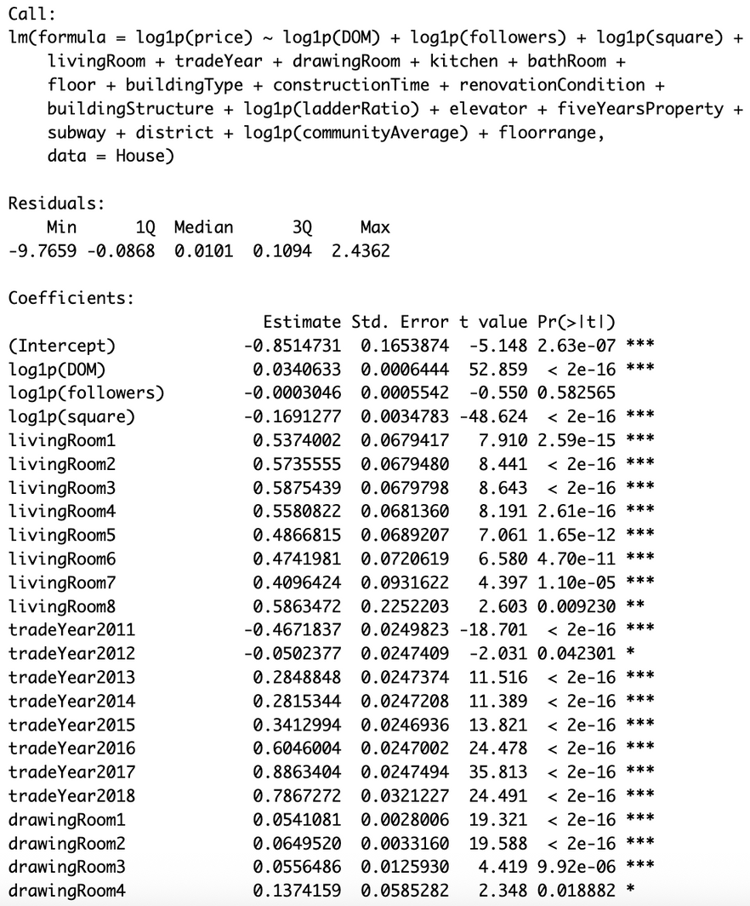
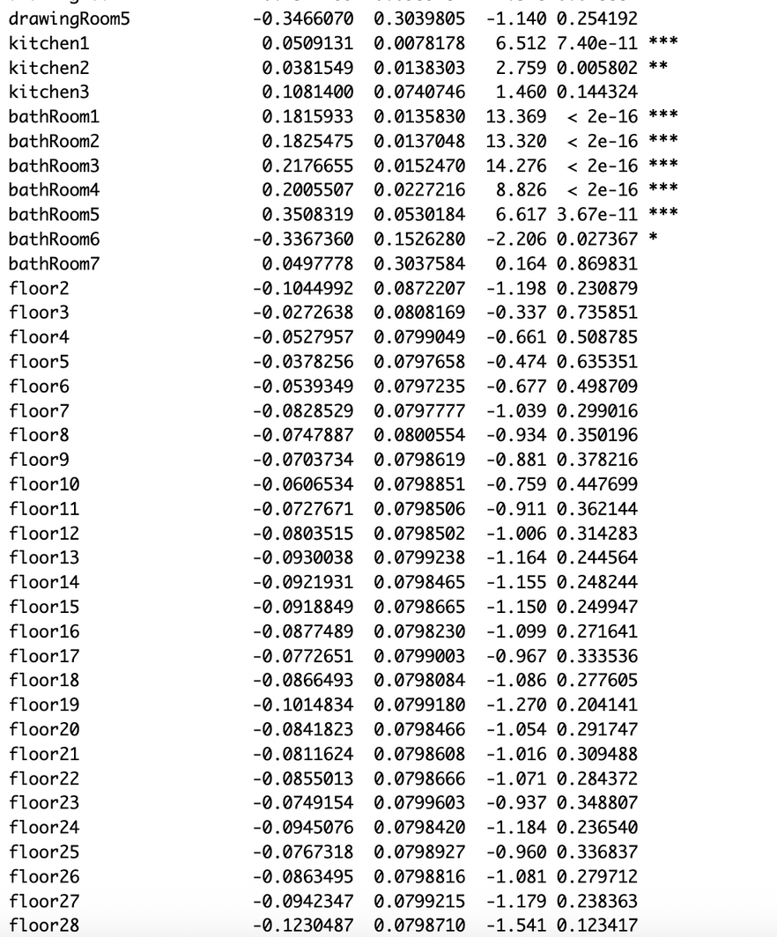

Slide 74
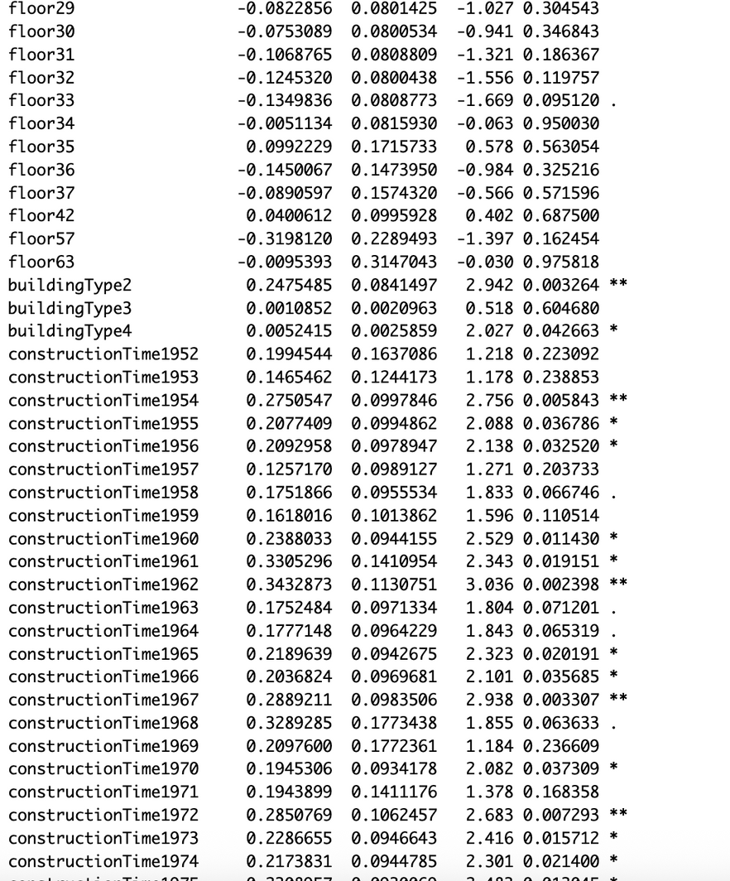
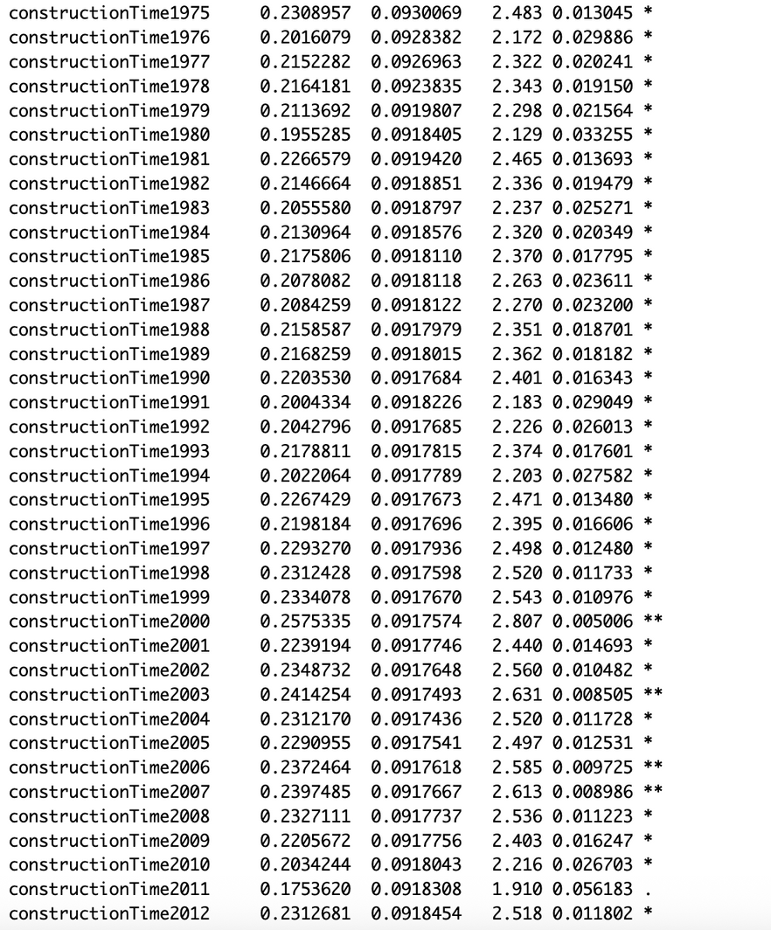

Slide 75
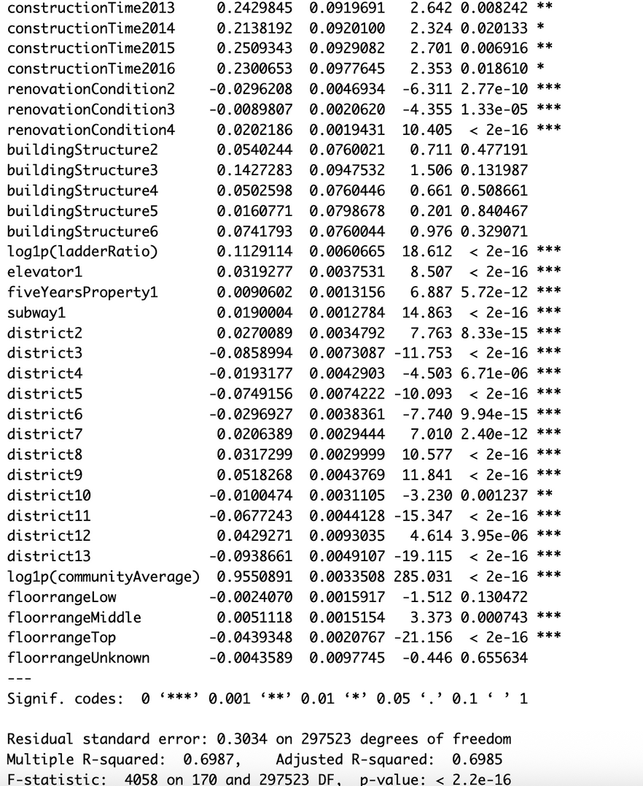

Slide 76
Appendix:
Random stuffs we did

Slide 77


Numerical variables

Slide 78

Examining Older Reports
  Within older properties, the renovation ladder still produces clear median price steps.
  Biggest marginal gain comes from moving poor to moderate renovation, where costs are manageable and payback is high.
  Returns taper at the very top, indicating a risk of over-capitalisation in this segment.
  Execution playbook: targeted kitchen and bath refresh, lighting, storage, and paint to shift the unit one level.
  Investor cue: repeatable trade = buy old at a discount, upgrade one level, exit into the larger ready-to-move-in buyer pool.

